Slide 1
WELCOME

Slide 2
IPL DATASET

Slide 3
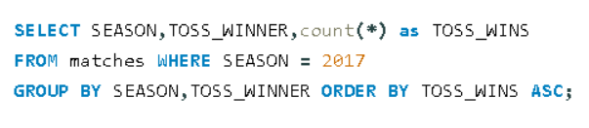
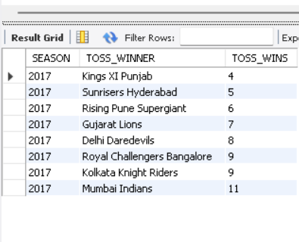
#1. HOW MANY TIMES DID EACH TEAM WIN THE TOSS IN SEASON 2017 & ORDER BY ASCENDING ORDER?
RESULT :

Slide 4
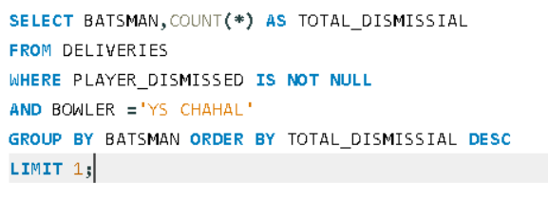
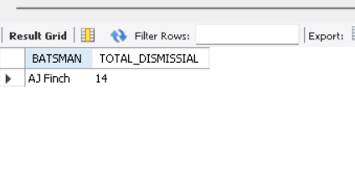
#2. WHICH BATSMAN BEEN DISMISSED BY THE BOWLER ' YS CHAHAL' MOST TIME?
RESULT :

Slide 5
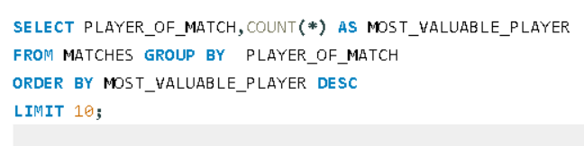
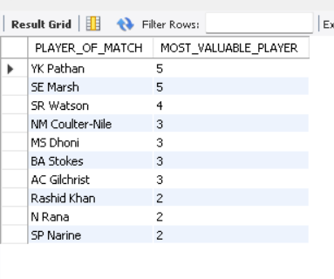
#3. WHO ARE THE TOP 10 PLAYERS GOT PLAYER OF THE MATCH AWARDS
RESULT :

Slide 6
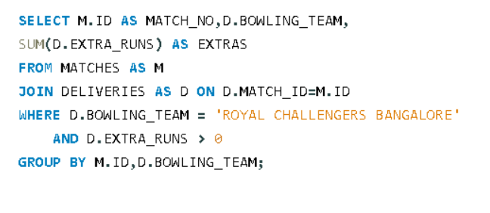
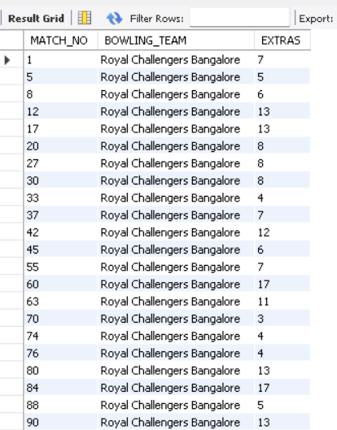
#4. HOW MANY EXTRAS ( WIDES & NO- BALLS) WERE BOWLED BY RCB IN EACH MATCH?
RESULT :

Slide 7
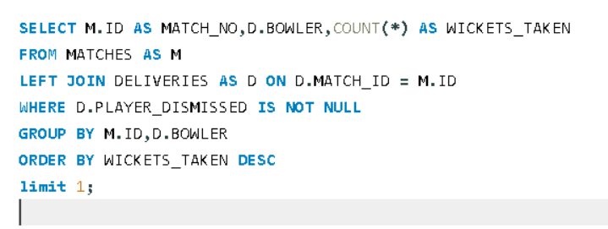
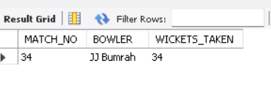
#5. WHICH BOWLER HAS THE MOST WICKETS TAKEN IN A SINGLE MATCH?
RESULT :

Slide 8
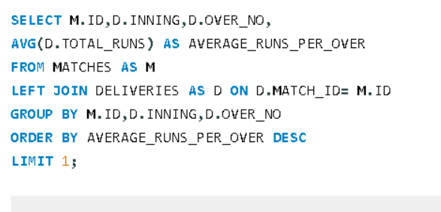
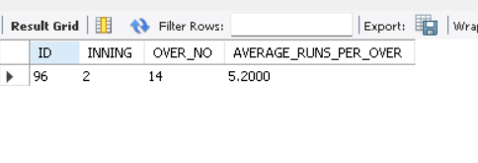
#6. WHAT IS THE HIGHEST AVERAGE NUMBER OF RUNS SCORED IN EACH OVER OF THE INNINGS IN EACH MATCH?
RESULT :

Slide 9
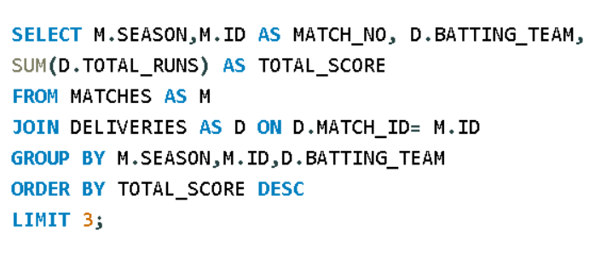
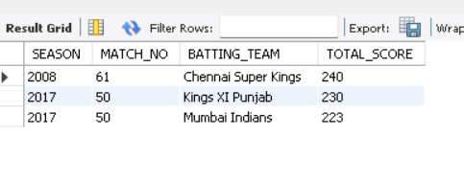
#7. WHICH TEAM HAS THE HIGHEST 3 TOTAL SCORE IN A SINGLE MATCH?
RESULT :

Slide 10
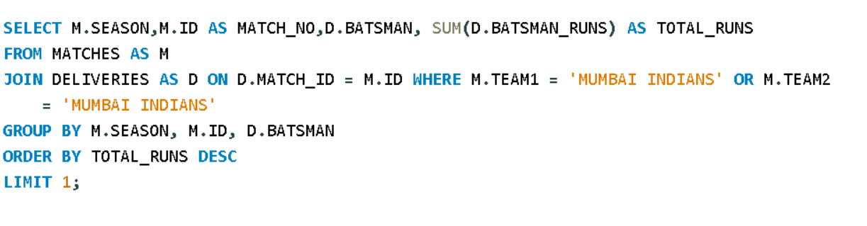
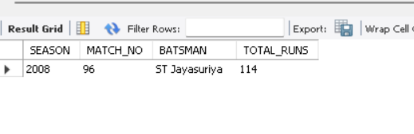
#8. WHICH BATSMAN HAS SCORED THE MOST RUNS IN A SINGLE MATCH IN MUMBAI INDIANS?
RESULT :

Slide 11
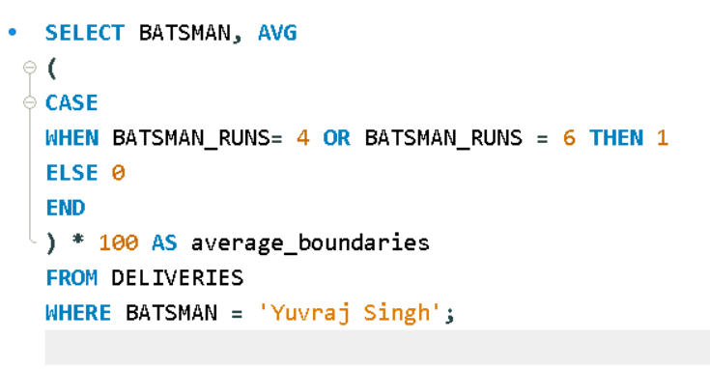
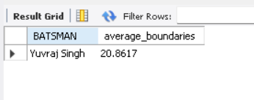
#9. WHAT IS THE AVERAGE PERCENTAGE OF BOUNDARIES AND SIXES HIT BY YUVARAJ SINGH?
RESULT :

Slide 12
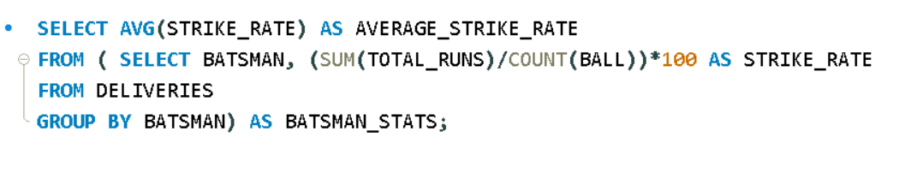
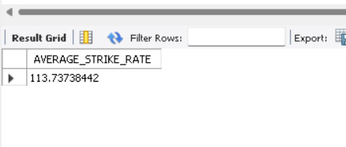
#10. WHAT IS THE AVERAGE STRIKE RATE OF BATSMEN IN THE IPL DATASET?
RESULT :

Slide 13
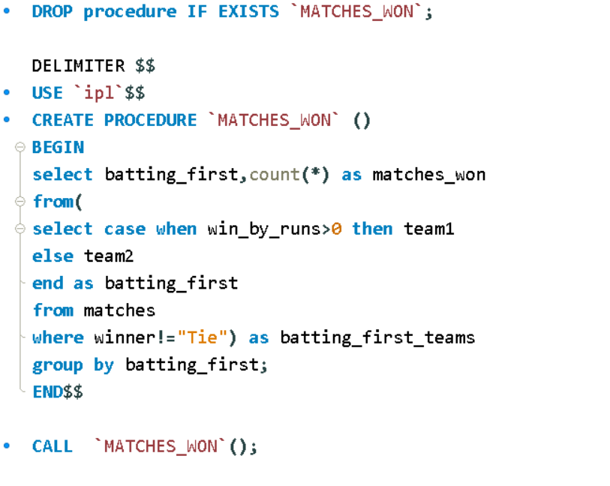
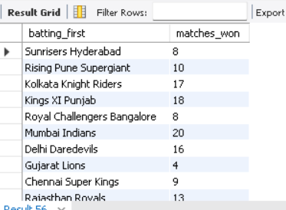
#11. WHAT IS THE NUMBER OF MATCHES WON BY EACH TEAM BATTING FIRST VERSUS BATTING SEACOND USING STORE PROCEDURE?
RESULT :

Slide 14
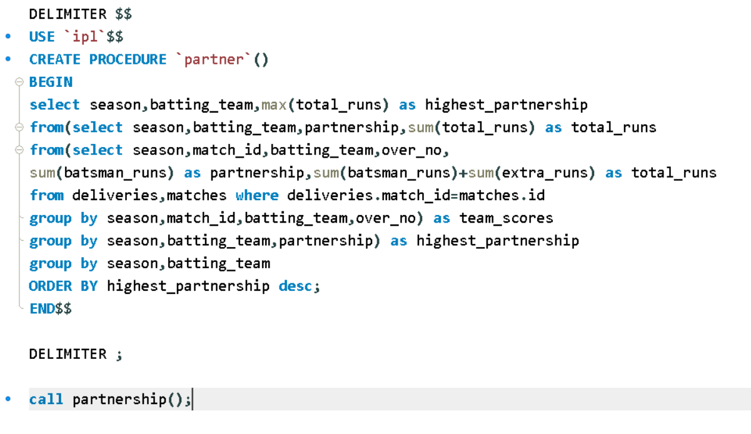
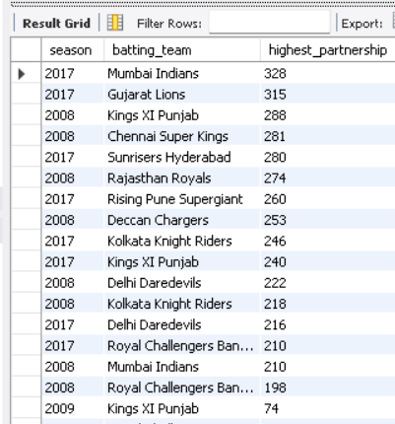
#12. WHAT IS THE HIGHEST PARTNERSHIP RUNS FOR EACH TEAM IN EACH SEASON?
RESULT :

Slide 15
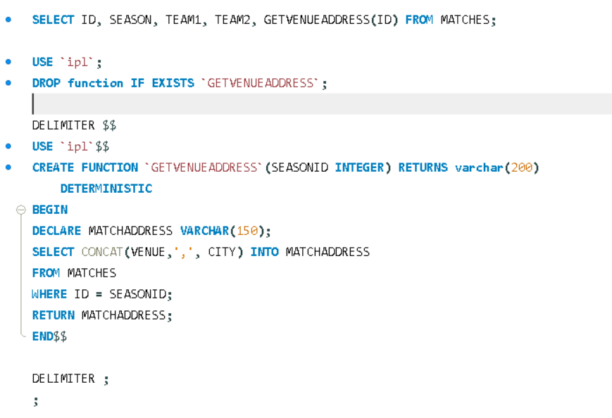
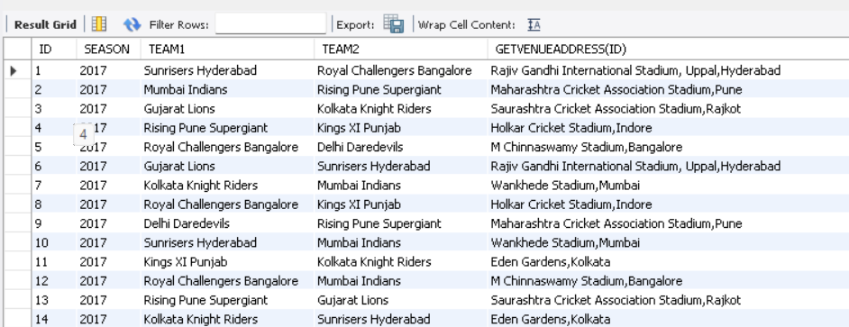
#13. CONCAT VENUE & CITY BY USING FUNCTION
RESULT :

Slide 16
#13. FIND THE ID 20, WHICH TEAM PARTICIPATE IN THAT ID, WINNER , PLAYER OF THE MATCH AND CONCAT VENUE & CITY USING FUNCTION
RESULT :

Slide 17
THANK YOU

